Slide 1


Slide 2
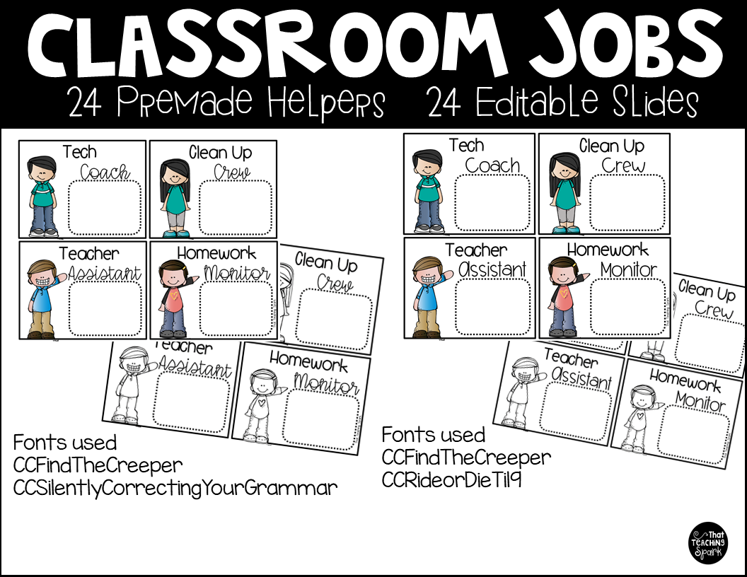

Slide 3
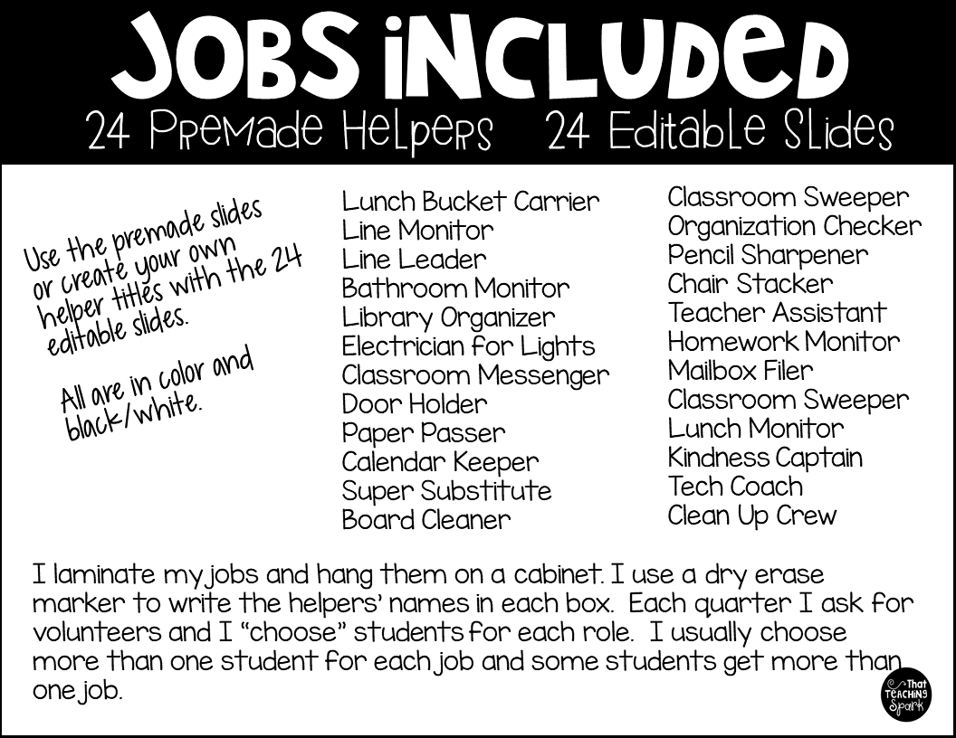

Slide 4
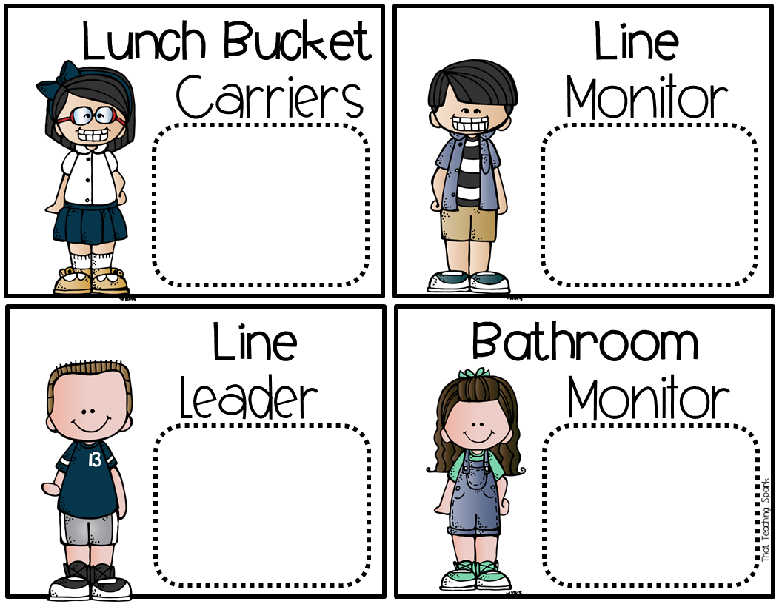

Slide 5


Slide 6
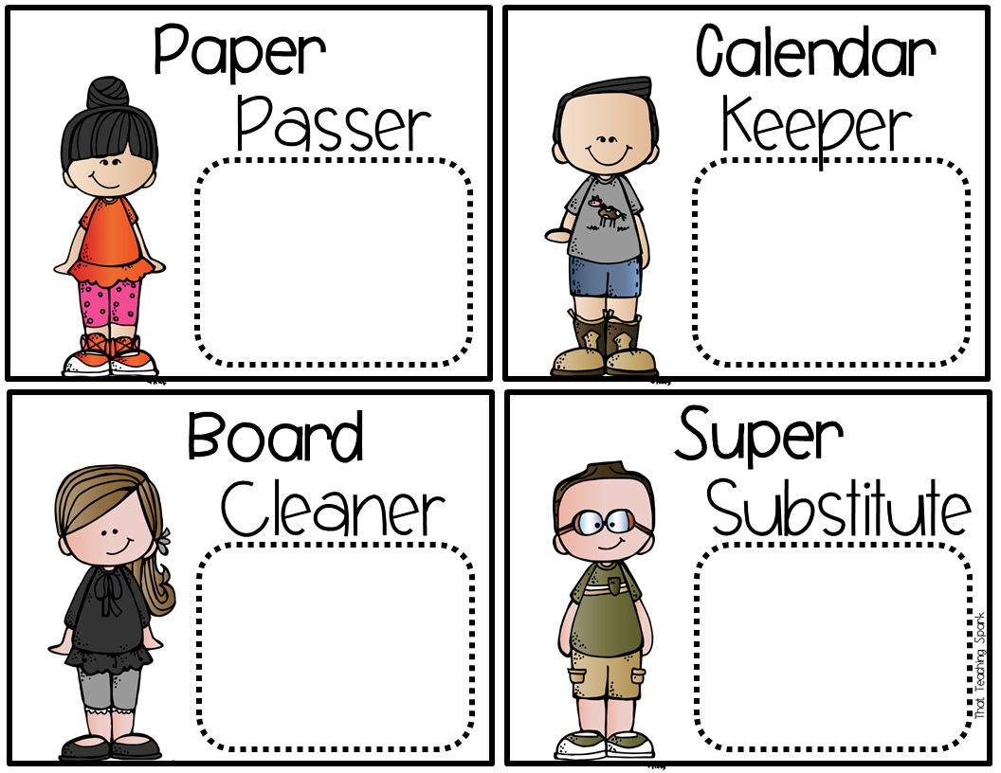

Slide 7


Slide 8


Slide 9
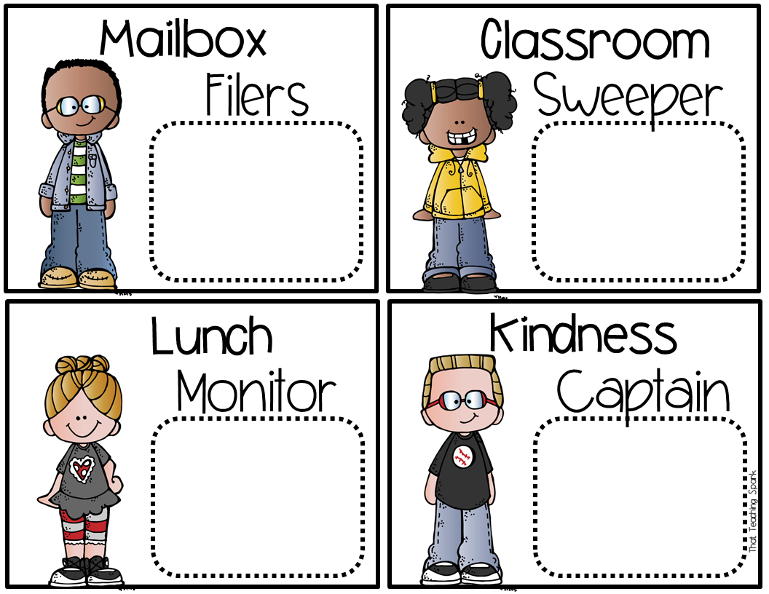

Slide 10
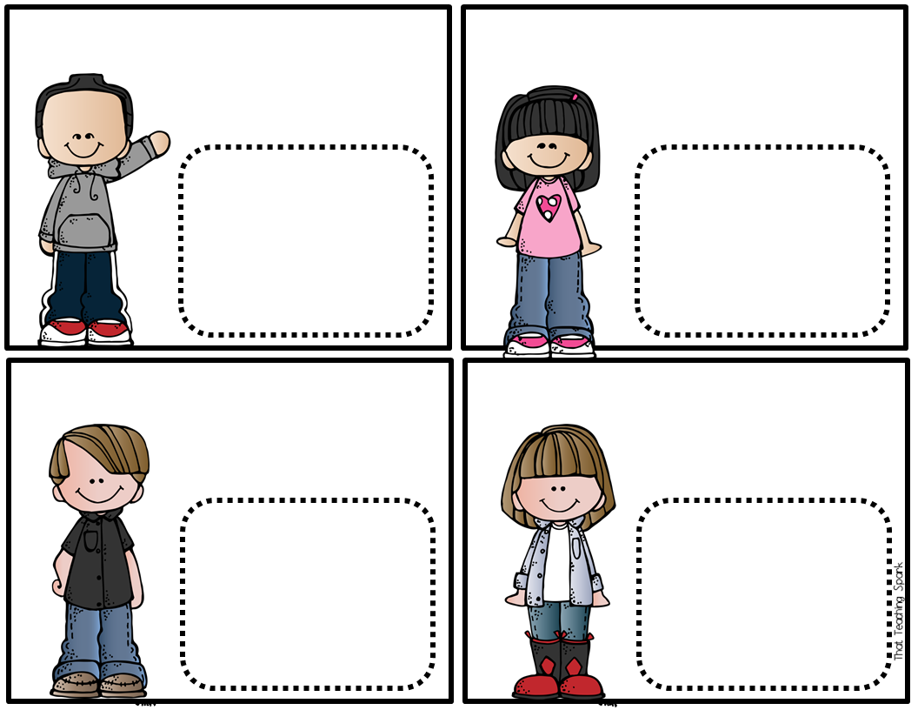

Slide 11
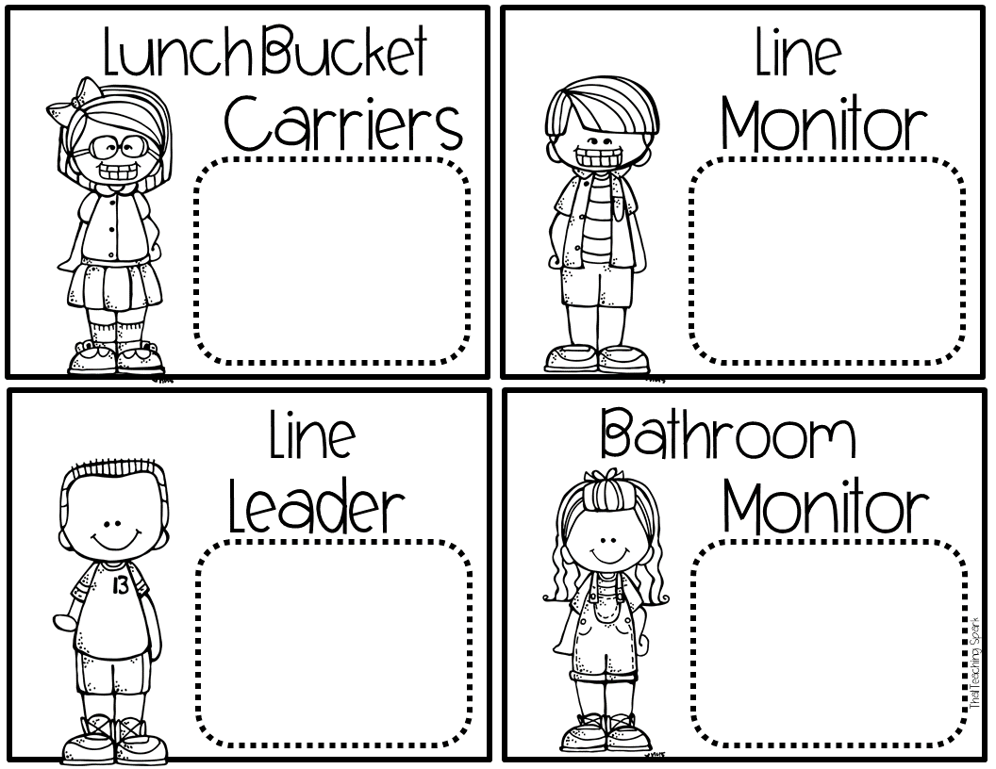

Slide 12
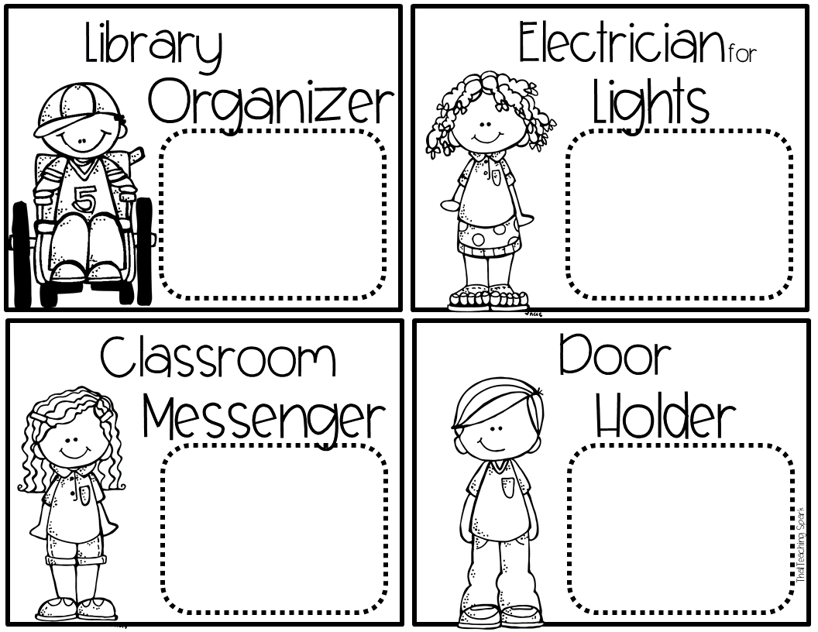

Slide 13
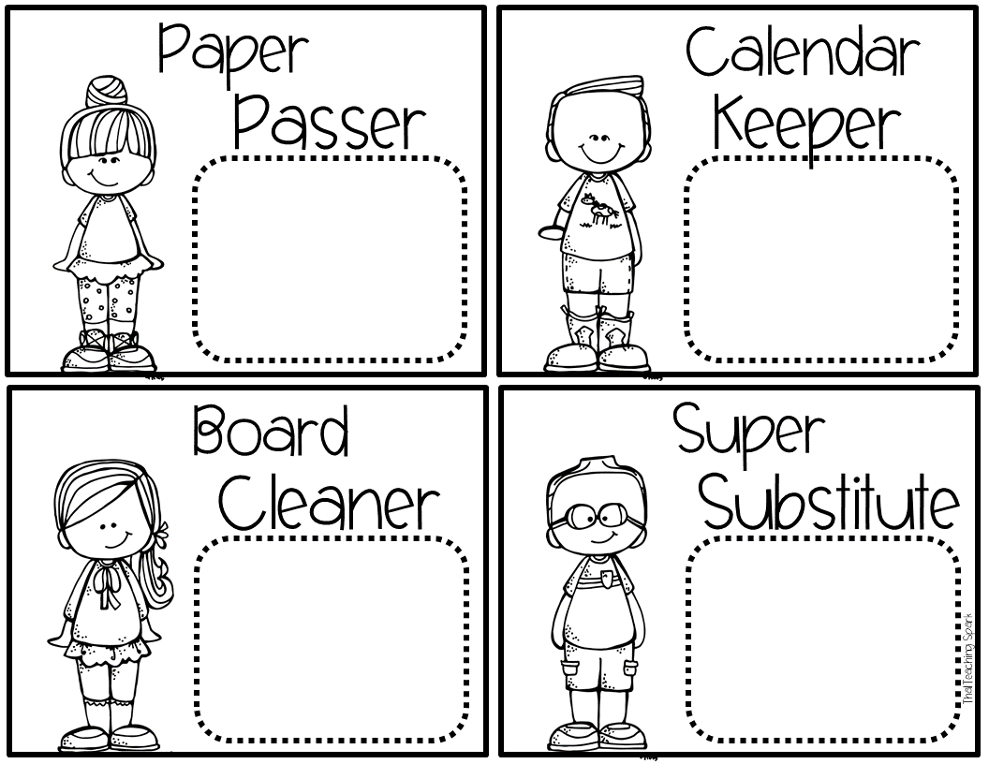

Slide 14
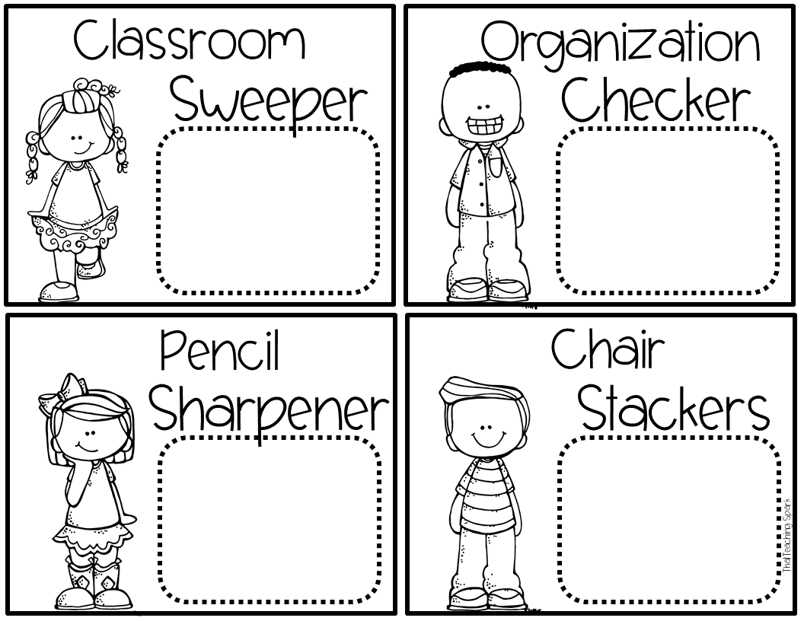

Slide 15


Slide 16
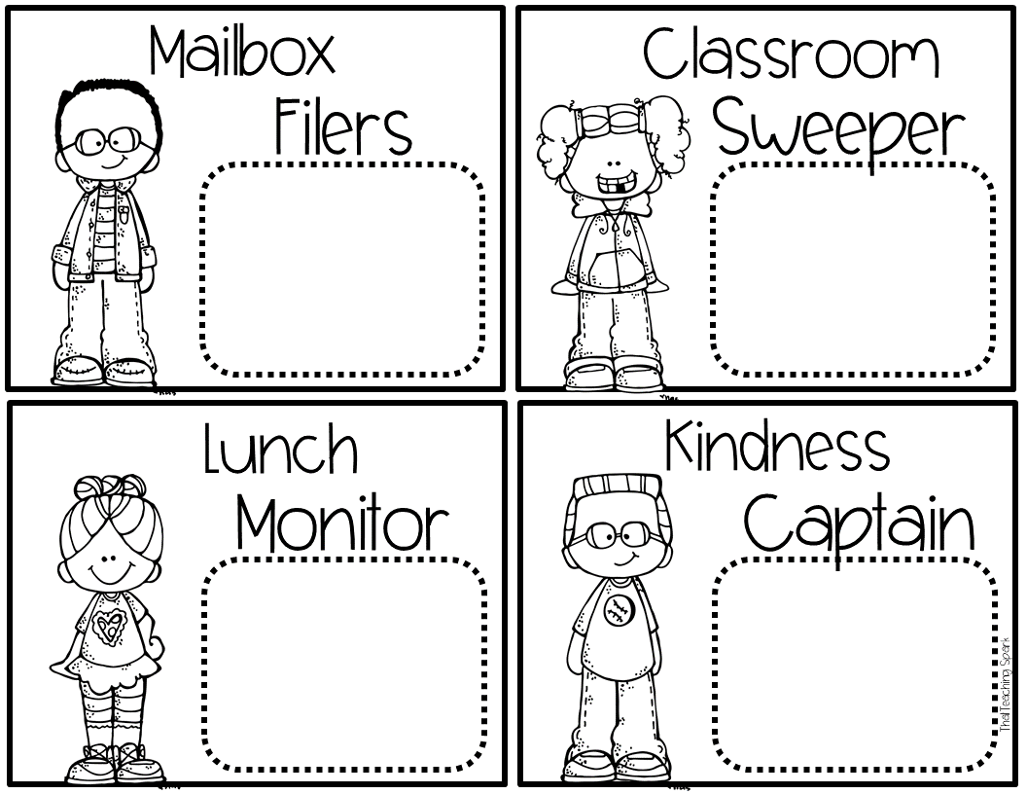

Slide 17
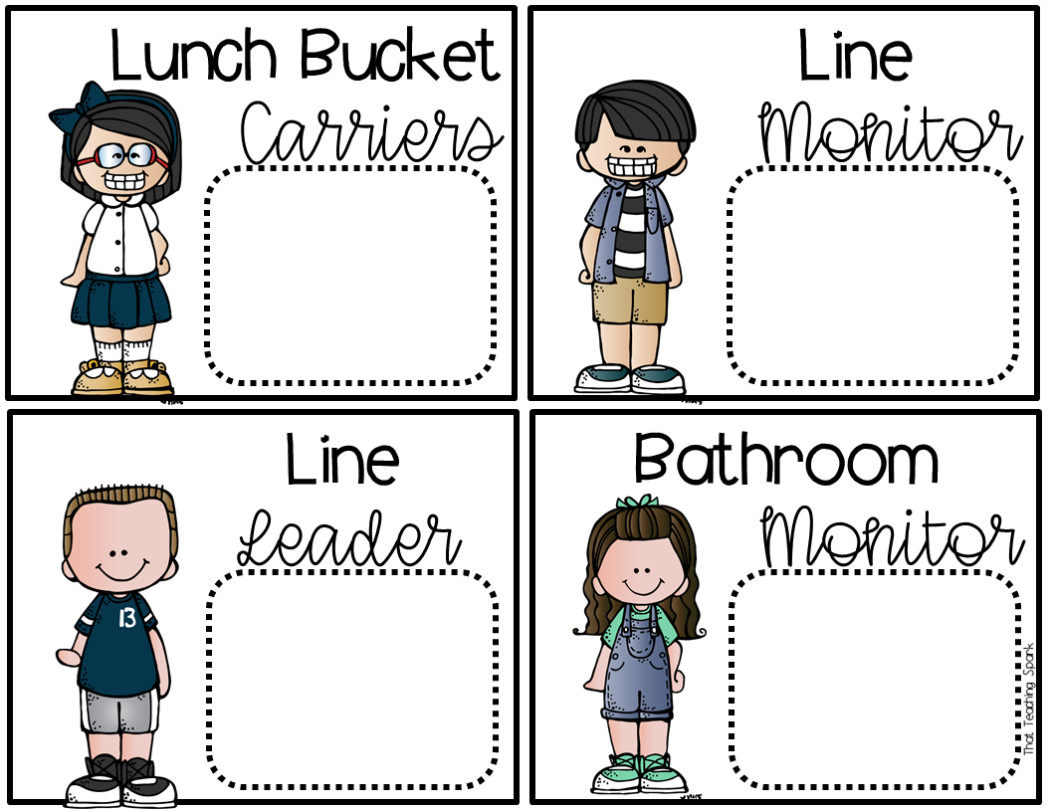

Slide 18


Slide 19


Slide 20


Slide 21


Slide 22


Slide 23
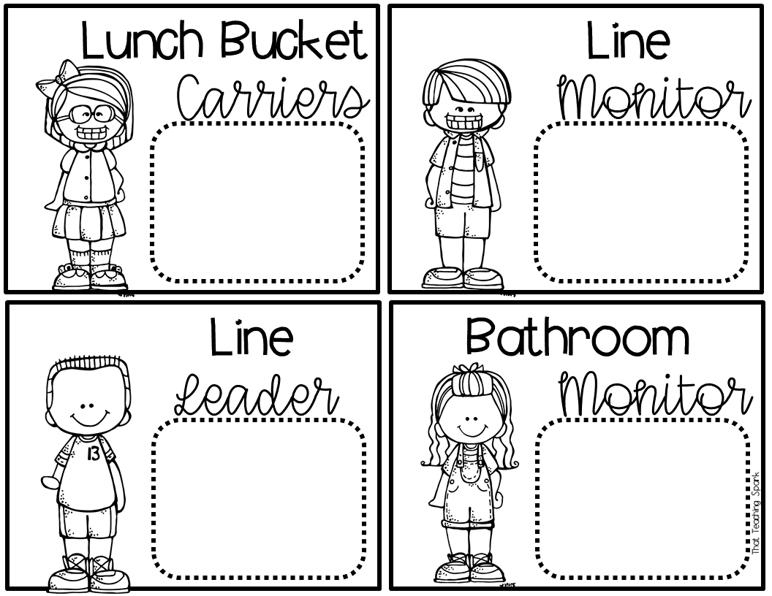

Slide 24


Slide 25
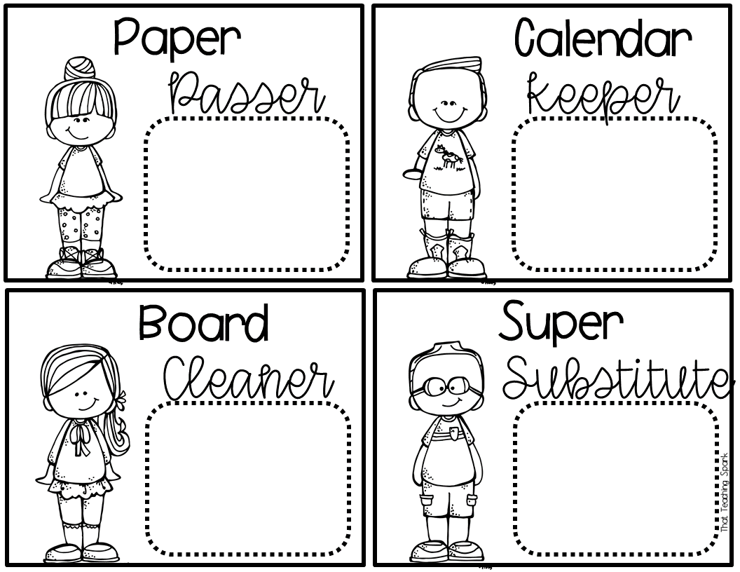

Slide 26


Slide 27


Slide 28
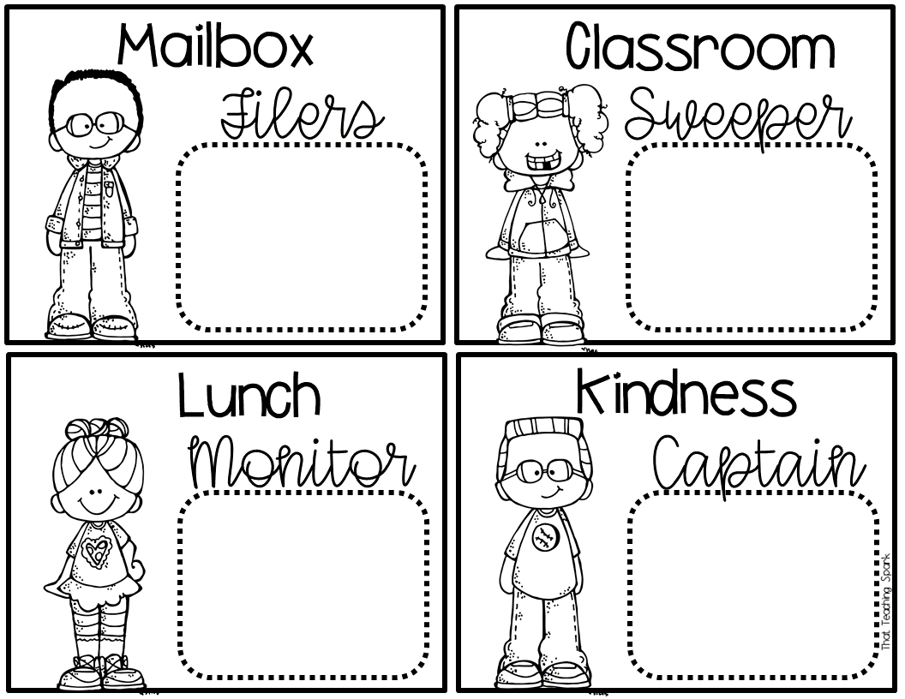

Slide 29
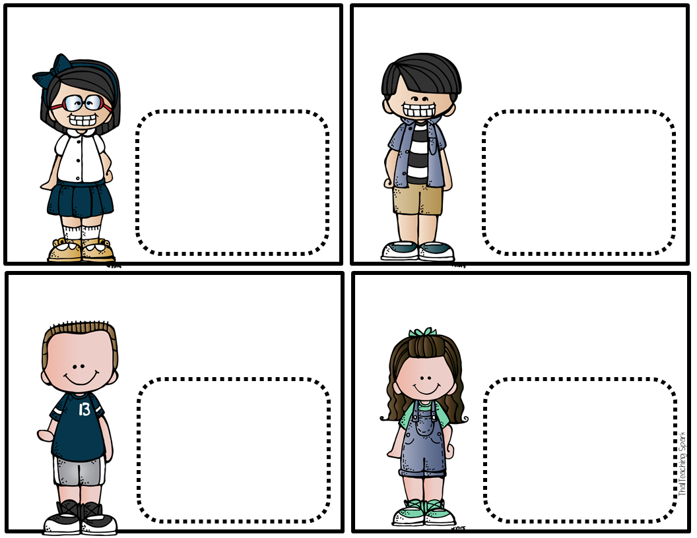
Type
Type
Type
Type

Slide 30

Type
Type
Type
Type

Slide 31
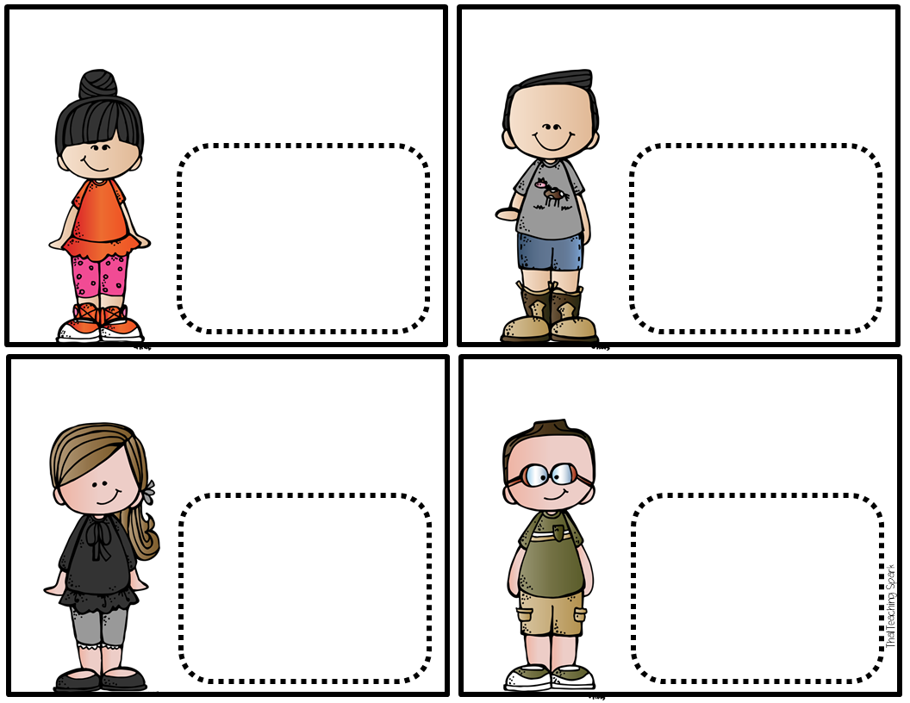
Type
Type
Type
Type

Slide 32
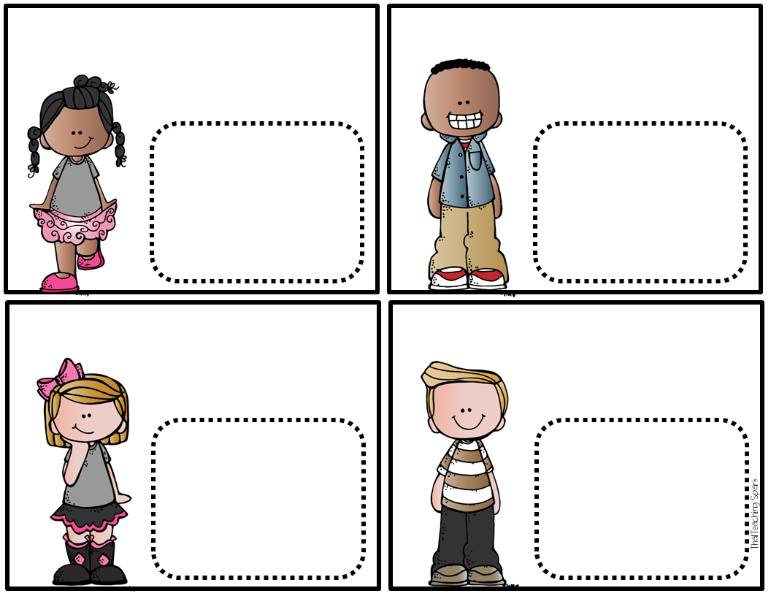
Type
Type
Type
Type

Slide 33
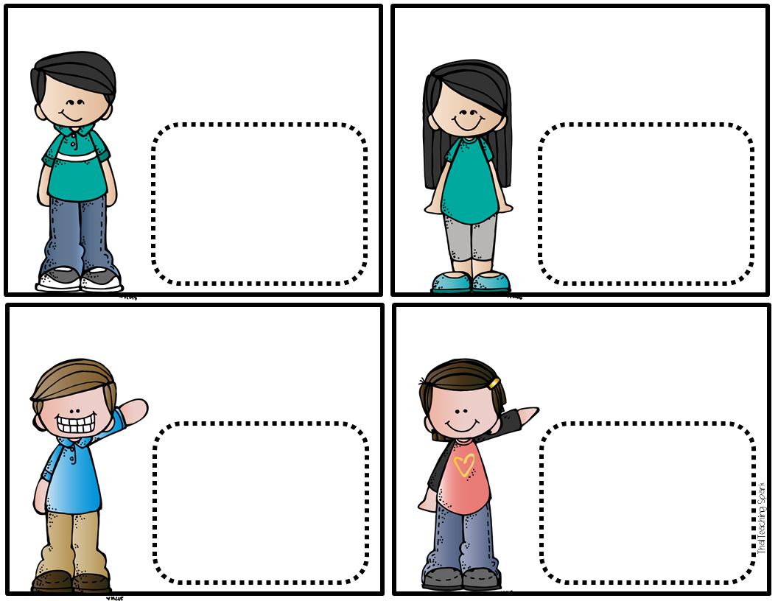
Type
Type
Type
Type

Slide 34
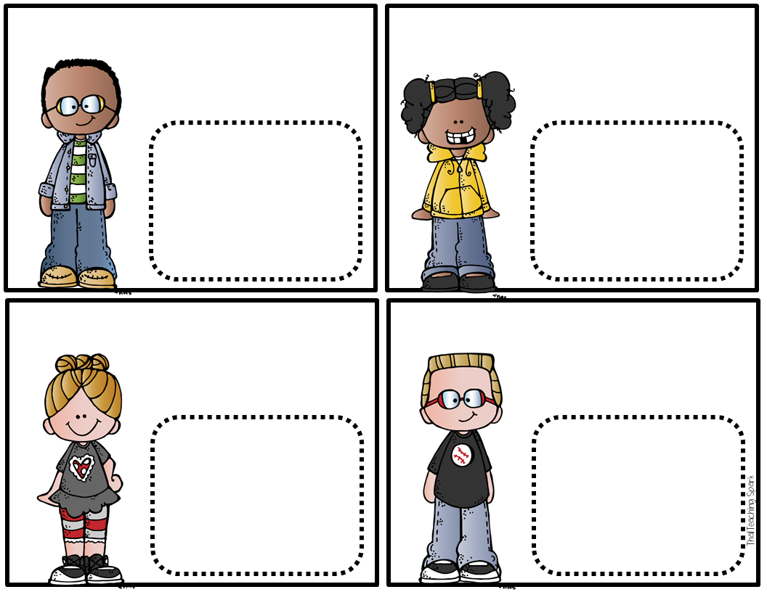
Type
Type
Type
Type

Slide 35
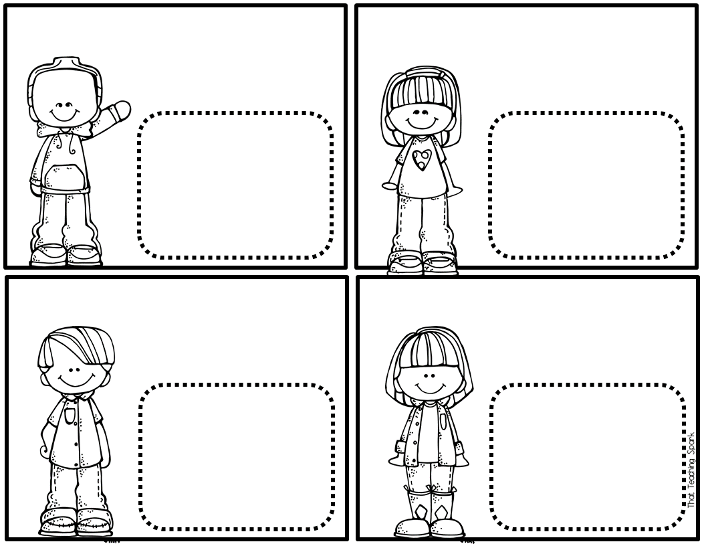
Type
Type
Type
Type

Slide 36
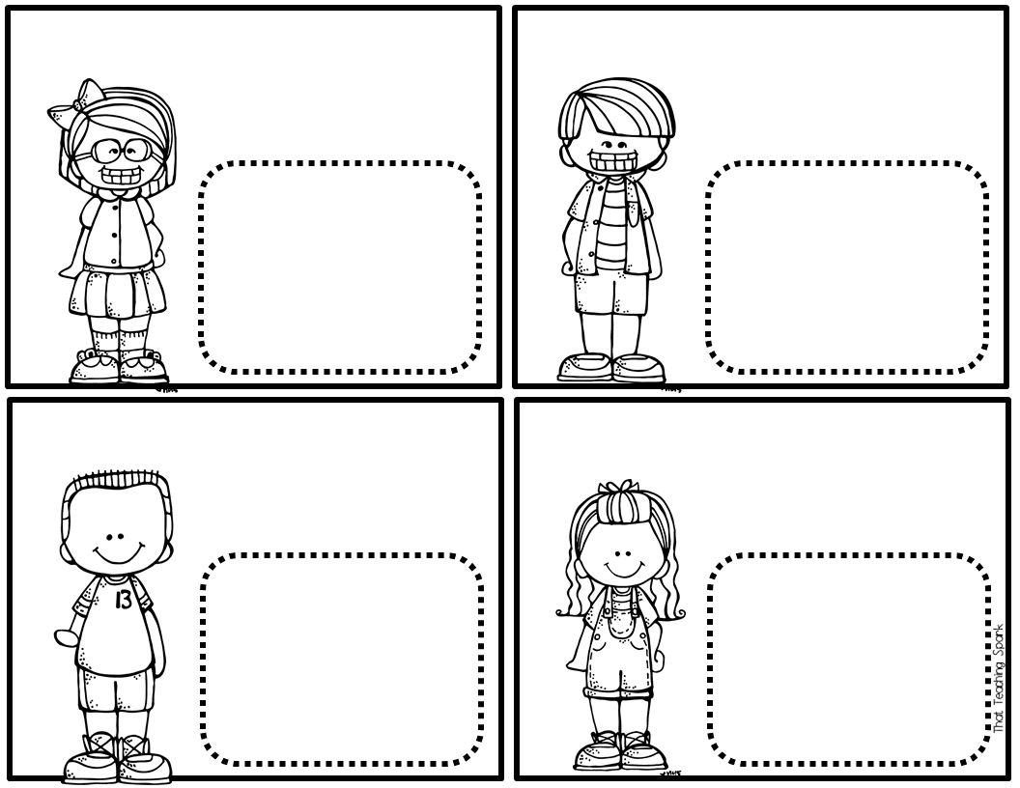
Type
Type
Type
Type

Slide 37
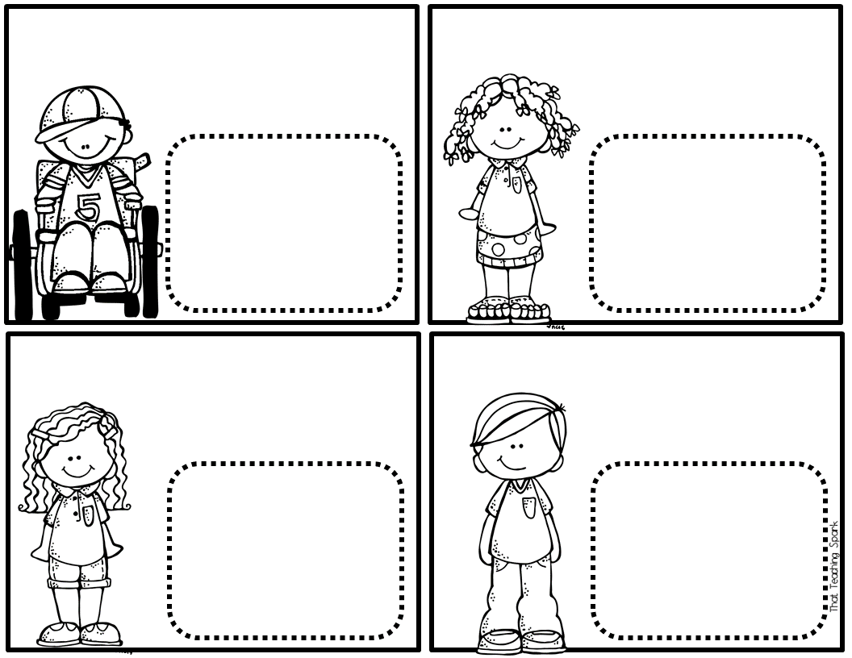
Type
Type
Type
Type

Slide 38
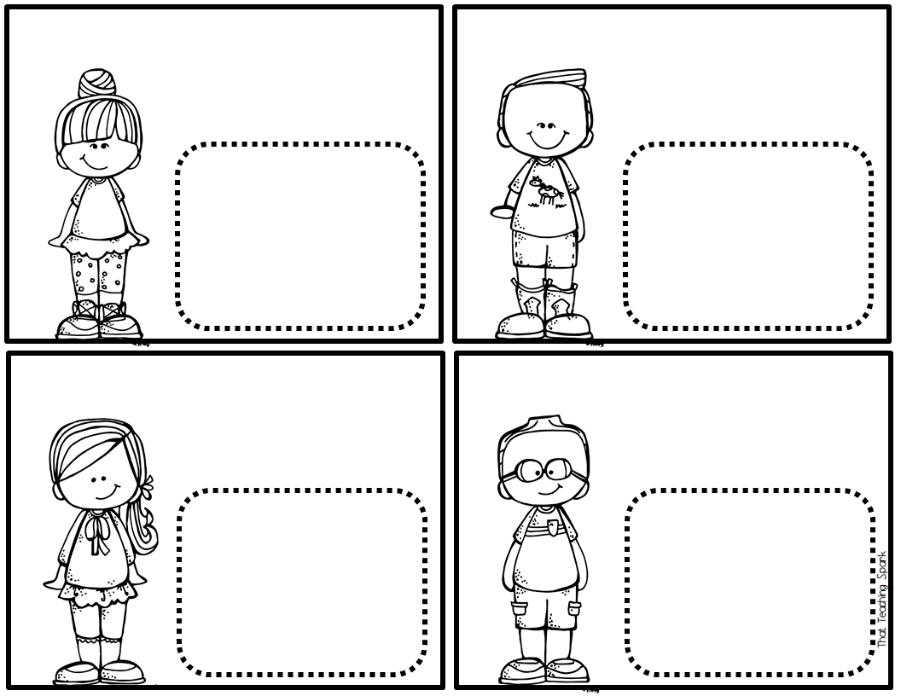
Type
Type
Type
Type

Slide 39
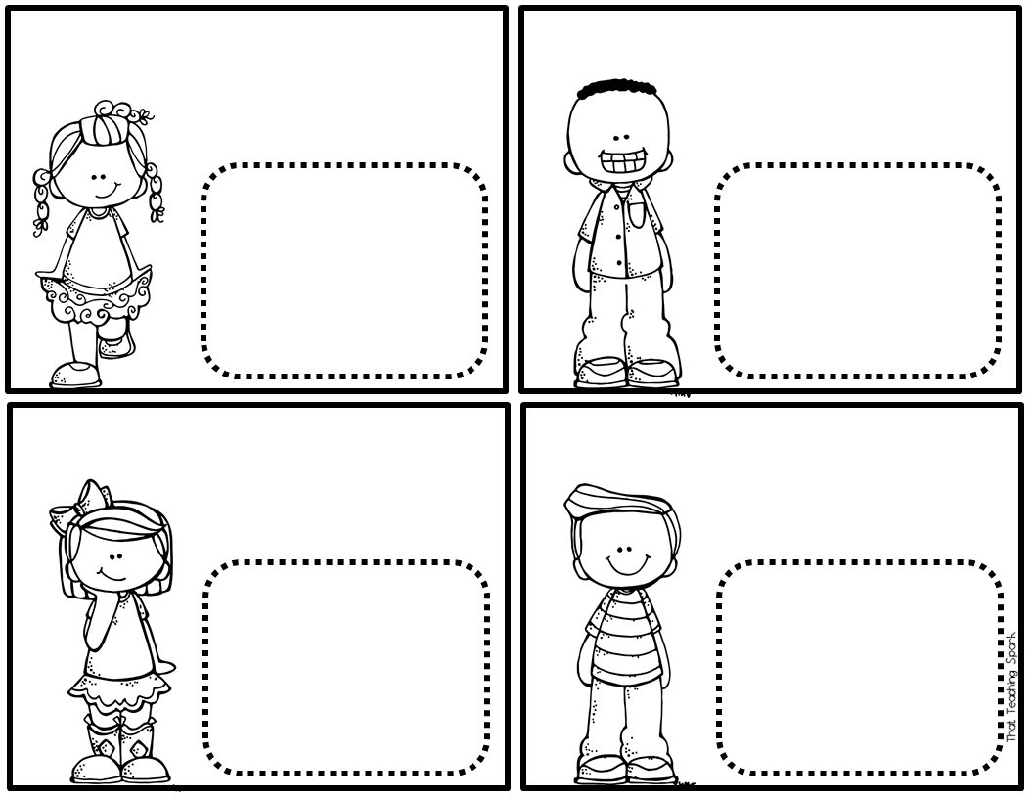
Type
Type
Type
Type

Slide 40
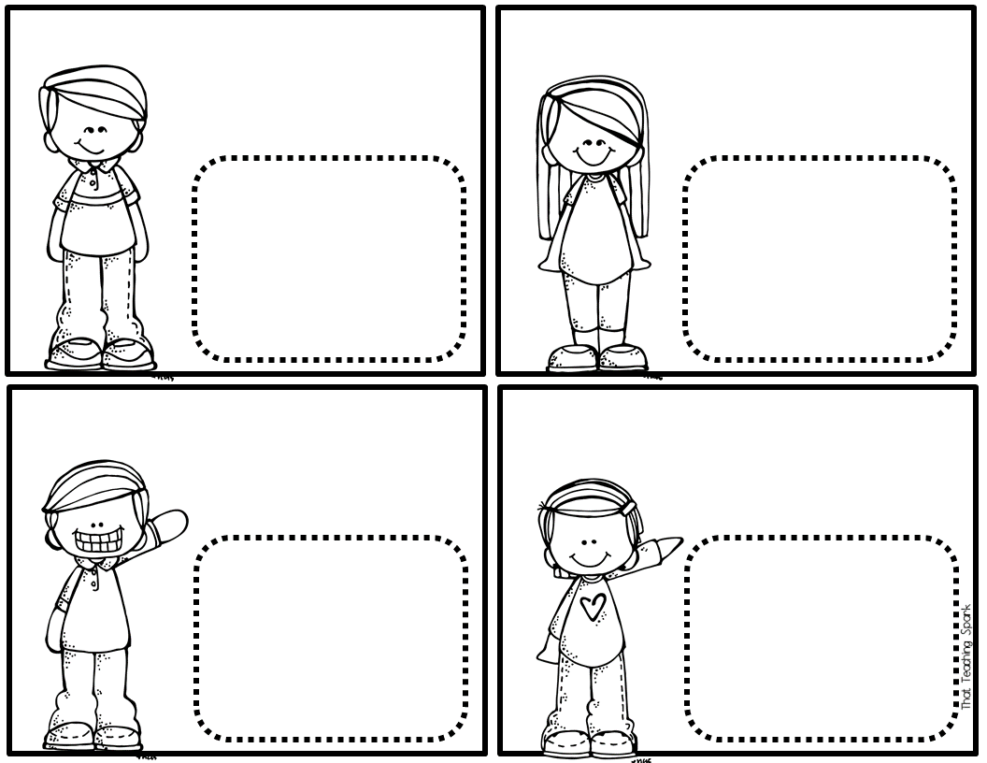
Type
Type
Type
Type

Slide 41
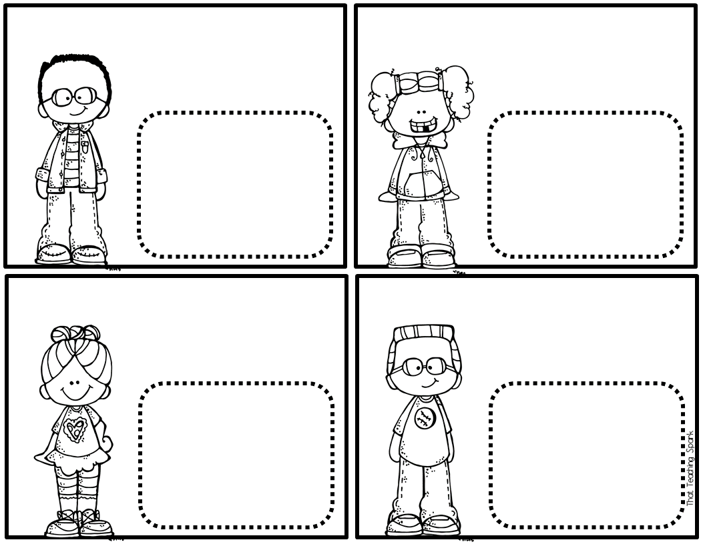
Type
Type
Type
Type

Slide 42


